Slide 1


Hackathon
Austin 2018

Slide 2
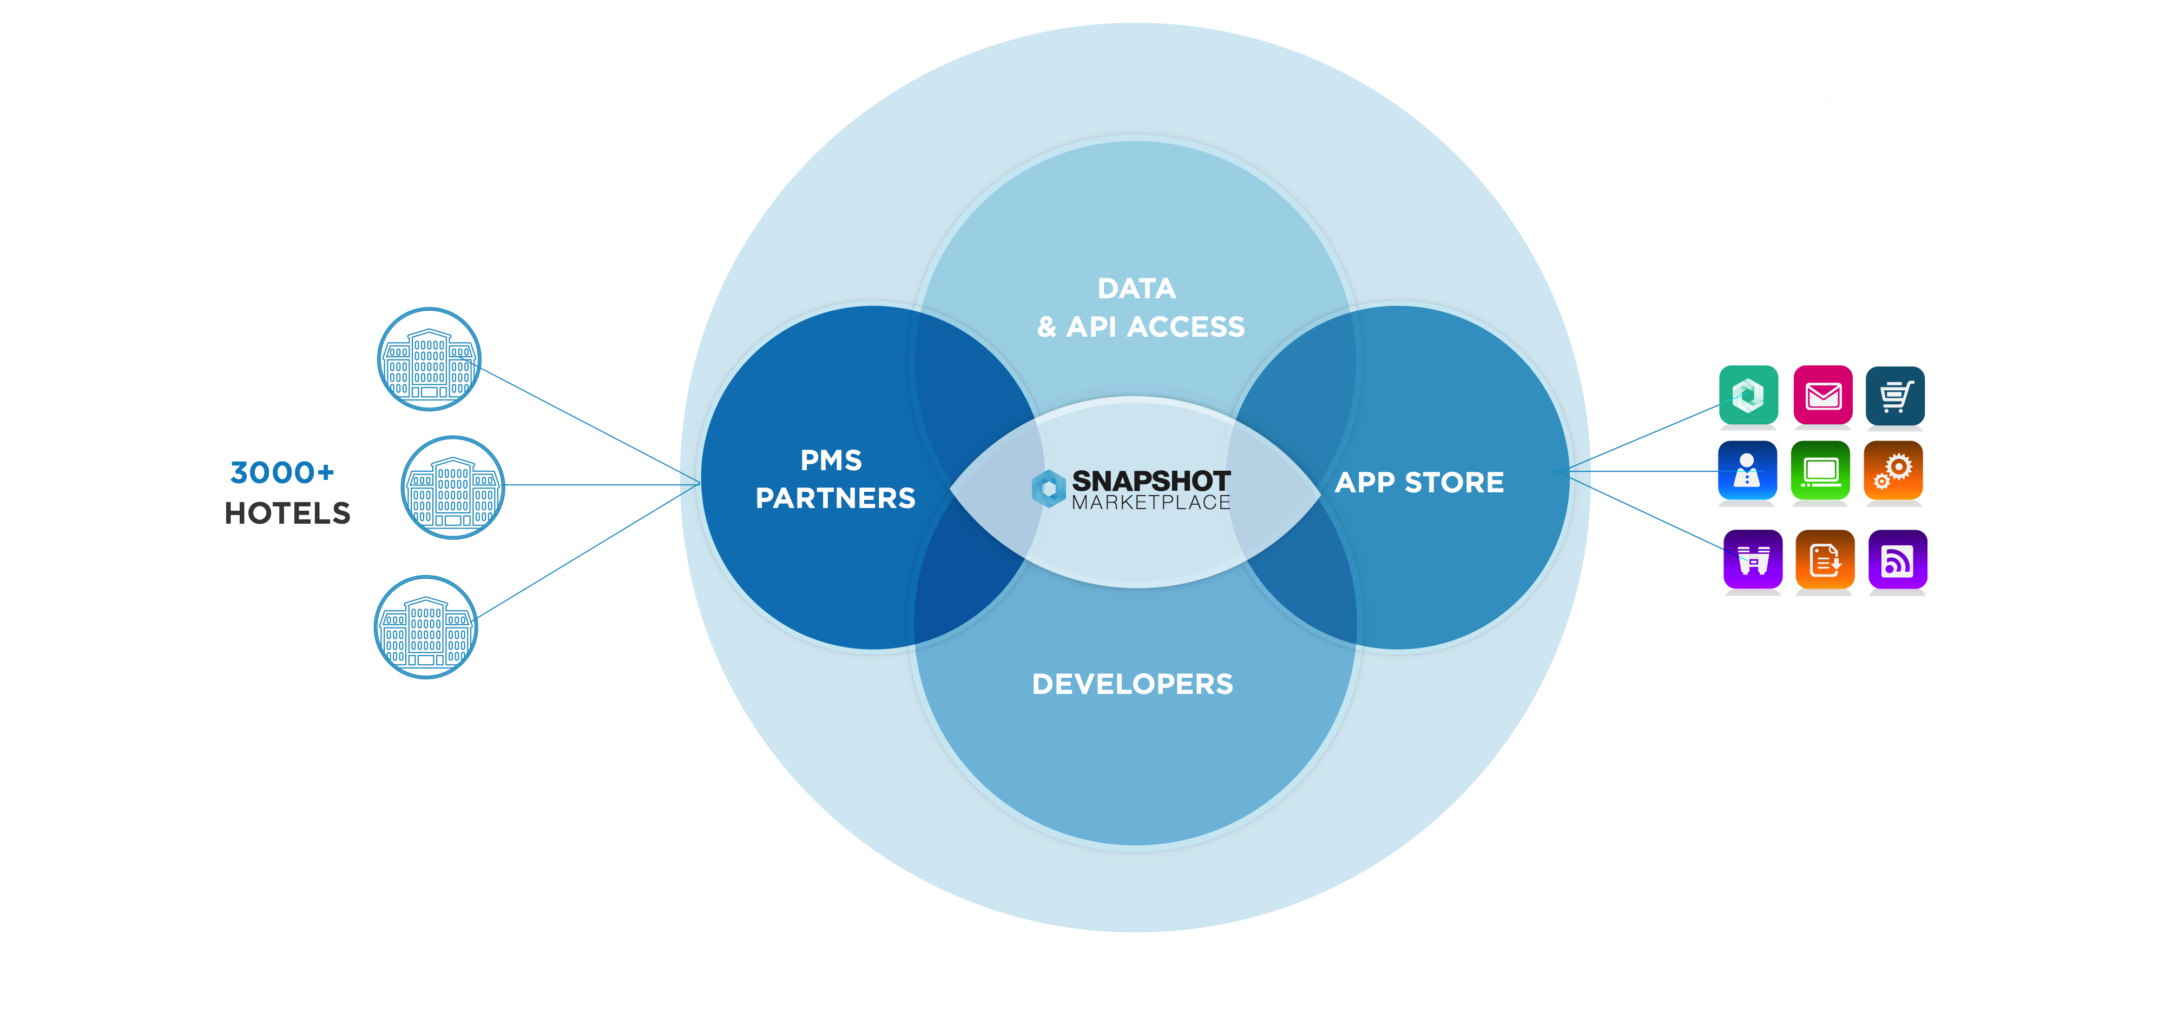

Slide 3
APIs Overview
AVAILABLE SERVICES
PMS Data
Identity
Other Data
Fabric
Reservations, Revenue
Authentication / Authorization
Social Media, Google Analytics
Hotel Communication
Reservations list, on the books aggregated data
Access to properties, customers, users, roles
Facebook, Twitter, Instagram, Google Analytics
Communication between users in the hotels (hotel staff)

Slide 4
GENERAL

Slide 5

BEST PRESENTATION TEMPLATE
. REST / JSON
Oauth2 – support multiple flows – Authorization Code Grant (SSO), Service Access Token (app only context), Password Flow, Single Sign Out
Access token – short lifetime, Refresh token – long lifetime
Developer portal: https://developers.snapshot.travel – some of the APIs are hidden under the link
API Console in developer portal – supports Identity, PMS data only
URLs: https://europewest-api-sandbox.snapshot.technology/oauth/token, https://europewest-api-sandbox.snapshot.travel.technology//v1/{API}
Fabric: https://fabric-sandbox.snapshot.travel/ for UI and https://fabric-sandbox.snapshot.travel/api for API
General format: /v1/{API}/{property_id/customer_id}/{API}?query_params
You have access to sample (fake) data – no real data of real hotels, PMS data are updated on daily basis
Information to configure in the application – Number of rooms, currency, VAT ID – list is going to be provided
Each team has separate customer and app with 5 users, only Paul has access to developer portal, other users are there for the Fabric

Slide 6
IDENTITY

Slide 7

C
P
U
Customer
Property
User
Tenant / Account / Legal enity
Hotel
Person
Customer of Snapshot who signed up one or multiple hotels for the service and gets charged
A hotel. All the data are originally gathered for a single property. Properties can be grouped to property sets
Person who operates the application. Person who can be messaged or tasked in Fabric.

Slide 8
C
P
P
P
U
P
P
P
U
Excluded:
Groups of users
Application permissions
User roles / permissions
Property sets
SSO / Navbar
Multicustomer scenarios
Getting context:
/identity/properties
/identity/customers

Slide 9
PMS DATA

Slide 10
Reservation list
On the books
Dictionaries
Only one endpoint, returns list of reservations
Both past and future
Details like status, dates, contact details, revenue, room number, room type, …
Aggregated values based on reservation details
Average daily rate, Revenue per available room, Occupancy, Revenue, Room nights
Aggregated on daily, weekly, monthly, whole data range granularity
Aggregated per dimensions: market segments, channels, room types, rate plans, …
Different time dimensions – as of date, pace endpoint (difference over time)
Forecast and budget data
Dimensions
Selection / filtering lists of all possible room types, channels, segments, …
Sometimes, the list can be pretty big (e.g. travel agents)

Slide 11
OTHER DATA

Slide 12


Facebook
Instagram
Twitter
Google Analytics
Facebook pages
Likes, views, …
Latest posts
Pictures
Hearts, replies, …
Tags
Tweets
Likes, retweets, …
Latest tweets
Views, Revenue, …
Dimensions like countries or channels

Slide 13
FABRIC

Slide 14
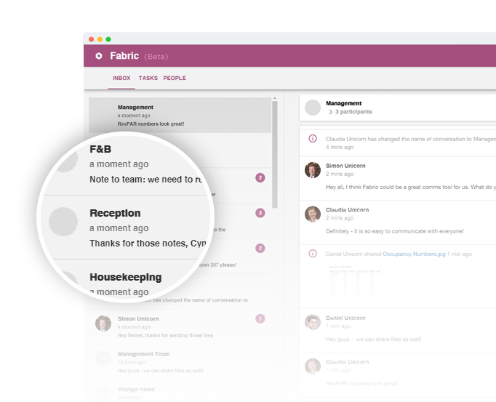
FABRIC
Slack for hotels
Hotel staff communication (internal)
Messaging – dialog and messages
Tasks
Notifications – REST – polling, javascript SDK
Users endpoint
Fabric UI is available
Android native application

Slide 15

https://github.com/DominikPinterSnapshot/snapshot_hackathon
This presentation, Postman collection, PMS data information
Your feedback is more than appreciated!
Additional materials

Slide 16

How to contact us?
Slack:
Austinhackathon2018.slack.com, invite
Dominik Pinter
Skype:
dom.pinter
Phone / Whatsapp:
+420 606 602 413
E-mail:
dominik@snapshot.travel
Iris Steinmetz
Skype:
iris_snapshot
Phone / Whatsapp:
+491 512 312 8080
E-mail:
iris@snapshot.travel

Slide 17
Thank You
Questions?

